Slide 1
UMU Institutional Repository: what has been added and what’s next
Altmetric, Dimensions, Creative Commons, DOI entry and embargo
Library, Uganda Martyrs University | October 2026
Start with the contents ›
Notes:
Use the Start button, or press Page Down. In slide show mode the buttons at the top of each slide jump back to the contents.

Slide 2
Contents
1
What changed
Everything we added, at a glance
2
Embargo
Restrict a file for a set time
3
Altmetric
Donut on item pages, with examples
4
Dimensions
Citation circle beside the donut
5
Creative Commons
Licence step in the deposit form
6
DOI data entry
DOI choice, entry rules, clean-up
7
What’s next
ORCID, backups, visibility, policy
8
Sources
Links used for this work
In slide show mode, click a tile to jump to it. Each slide has a Contents button at the top, and screenshots of items open the live page.

Slide 3
What we changed on the IR
Contents
Next ›
Change | Where you see it | Status | Go
Altmetric donut, by DOI | Item page, under the abstract | Live | Open ›
DOI link with a “DOI” label | Item page | Live | Open ›
Dimensions citation circle | Item page, beside the donut | Live | Open ›
Creative Commons step in deposit form | Deposit form, required | Live | Open ›
CC licence and button on item page | Item page | Live | Open ›
DOI choice in the Identifiers list | Deposit form | Live | Open ›
Embargo options | File upload step | Already available | Open ›
DOI clean-up list for librarians | Spreadsheet, 315 rows | Ready to send | Open ›
Altmetric repository registration | Altmetric support reply | Done | Open ›
UMU IR listed on dspace.org | DSpace registry | Done | Open ›
Notes:
Status: Live means it is on ir.umu.ac.ug now. Embargo needed no change, only a review of the existing settings.

Slide 4
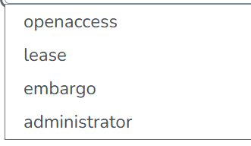
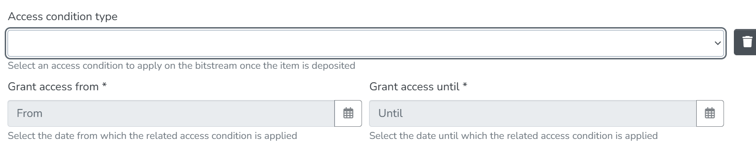
Embargo: already set up on file
‹ Back
Contents
Next ›
The file upload step offers four access conditions: open access, lease (up to 6 months), embargo (a start date up to 36 months ahead), and administrator-only.
Only the file is locked: an embargoed item’s title and abstract stay public.

Slide 5
Display Altmetric badges on simple item view
‹ Back
Contents
Next ›

Slide 6
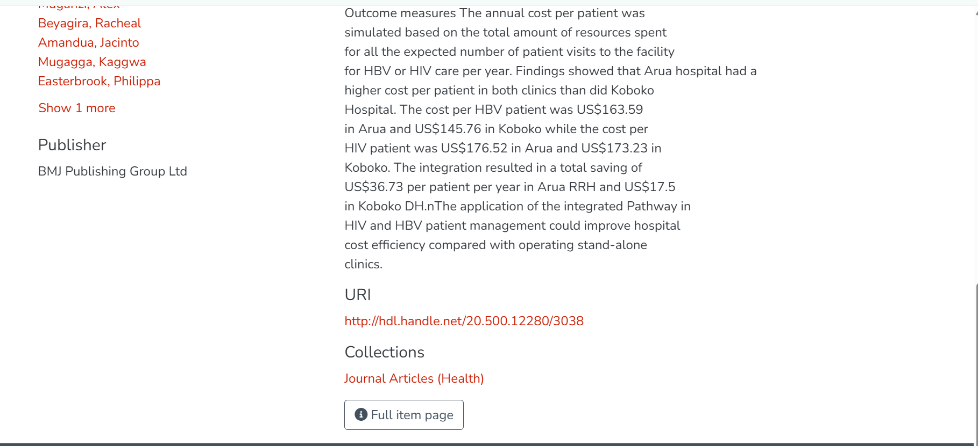
Before
‹ Back
Contents
Next ›

Slide 7
NOTE
‹ Back
Contents
Next ›
Put the DOI in dc.identifier.doi, written as a full link: https://doi.org/10.xxxx/xxxxx. Not DOI: 10.xxxx/..., not with spaces inside, and not in the citation or ISSN fields. That’s the standard DOI field, the page checks it first, and a full link is what makes the DOI link clickable.
When you deposit an item that has a DOI, go to Identifiers, choose DOI, and type the full link, e.g. https://doi.org/10.1234/abcd.5678. Don’t type “DOI:” in front, don’t leave spaces inside it, and don’t put a DOI under ISSN, URI or Other. Add the DOI of the item itself, not of a paper it cites.

Slide 8
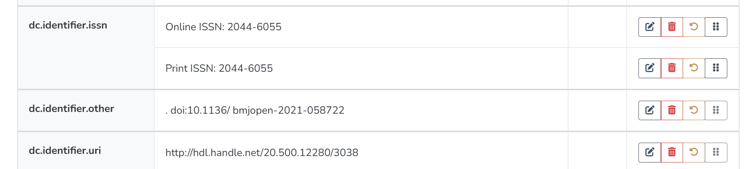
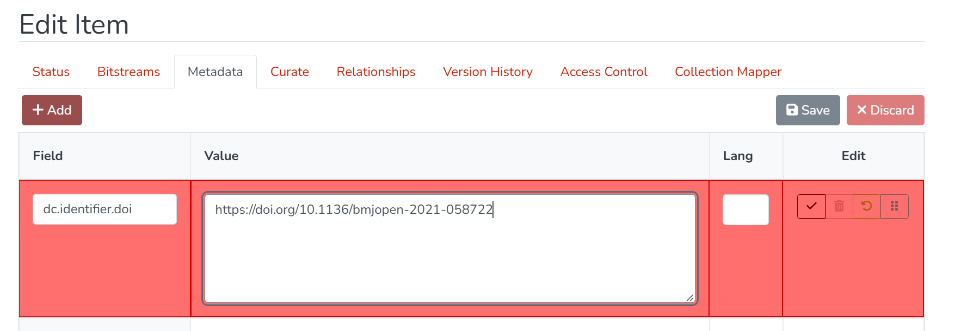
Edit the DOI field
‹ Back
Contents
Next ›
How the DOI was entered before
Where the DOI goes and how it should look

Slide 9
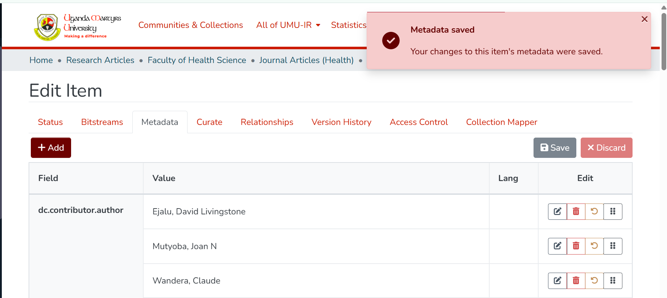
Save changes
‹ Back
Contents
Next ›

Slide 10
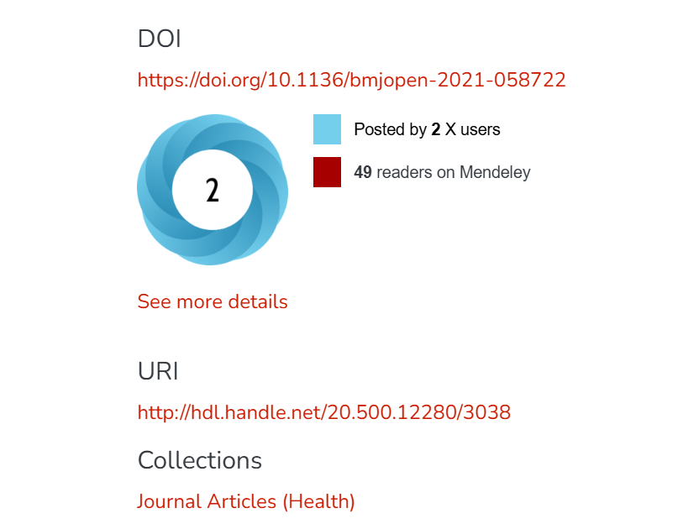
Altmetric Donut Added
‹ Back
Contents
Next ›
Example:
https://ir.umu.ac.ug/items/2782d841-e33b-4d79-9f90-e0c92d98fe52

Slide 11
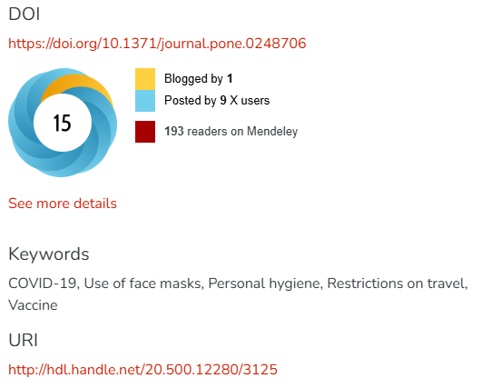
‹ Back
Contents
Next ›
Another example
Use of face masks to limit the spread of the COVID-19 among western Ugandans: Knowledge, attitude and practices
Kyamanywa, Patrick
https://ir.umu.ac.ug/items/08c9a987-a91f-4b55-bc6c-1512fffc1857

Slide 12
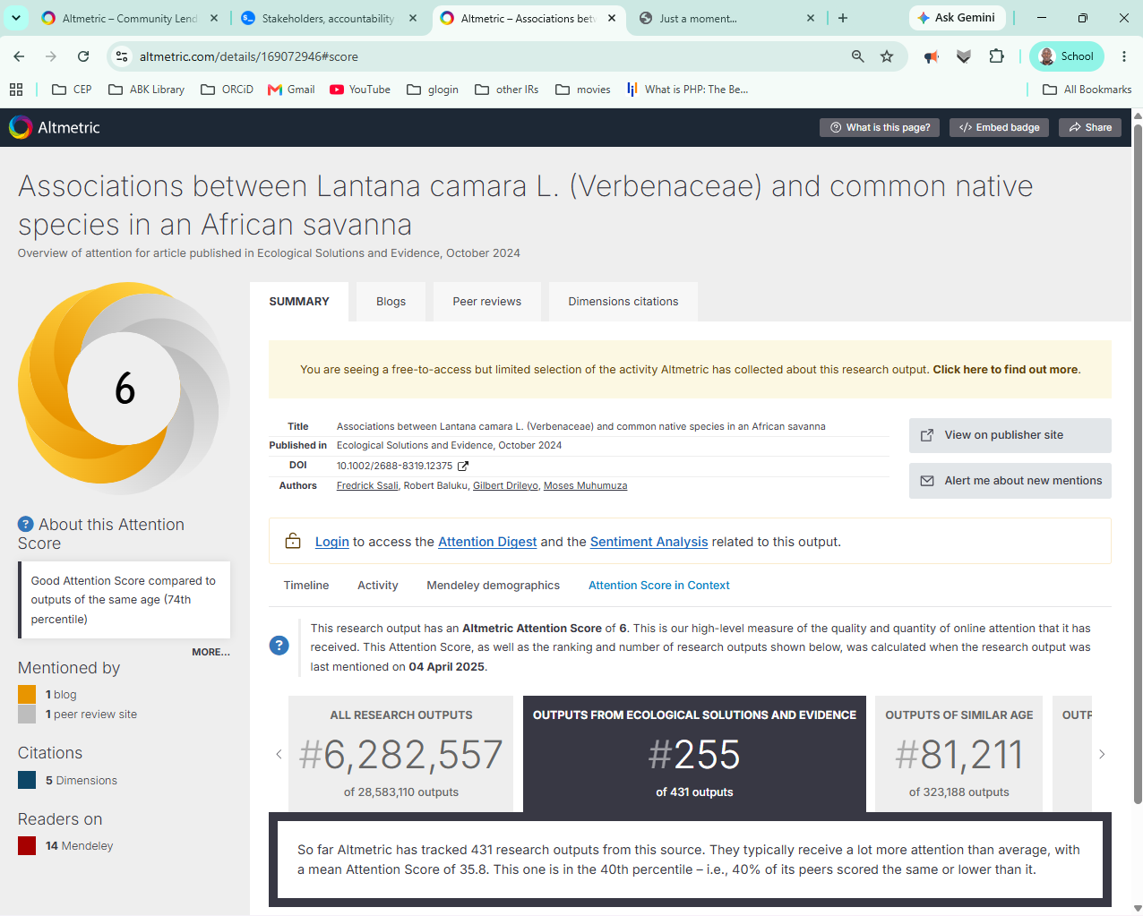
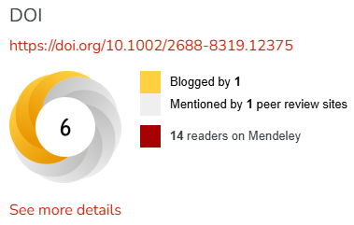
Altmetric explained
Associations between Lantana camara L. (Verbenaceae) and common native species in an African savanna
https://ir.umu.ac.ug/items/faa2f49c-83da-41f3-940c-aa6880cfc6a6
‹ Back
Contents
Next ›

Slide 13
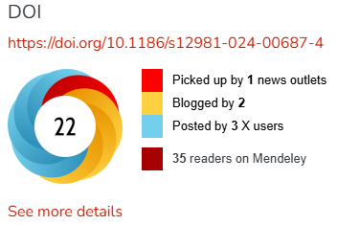
Make meaning of Altmetric
‹ Back
Contents
Next ›
Predictors of survival among older adults with HIV in Uganda’s AIDS support organization centers of excellence (1987 2023): a retrospective longitudinal study
Atuhairwe, Christine
https://ir.umu.ac.ug/items/9bed6aff-00f0-418f-9b0d-1a11d2592ebd

Slide 14
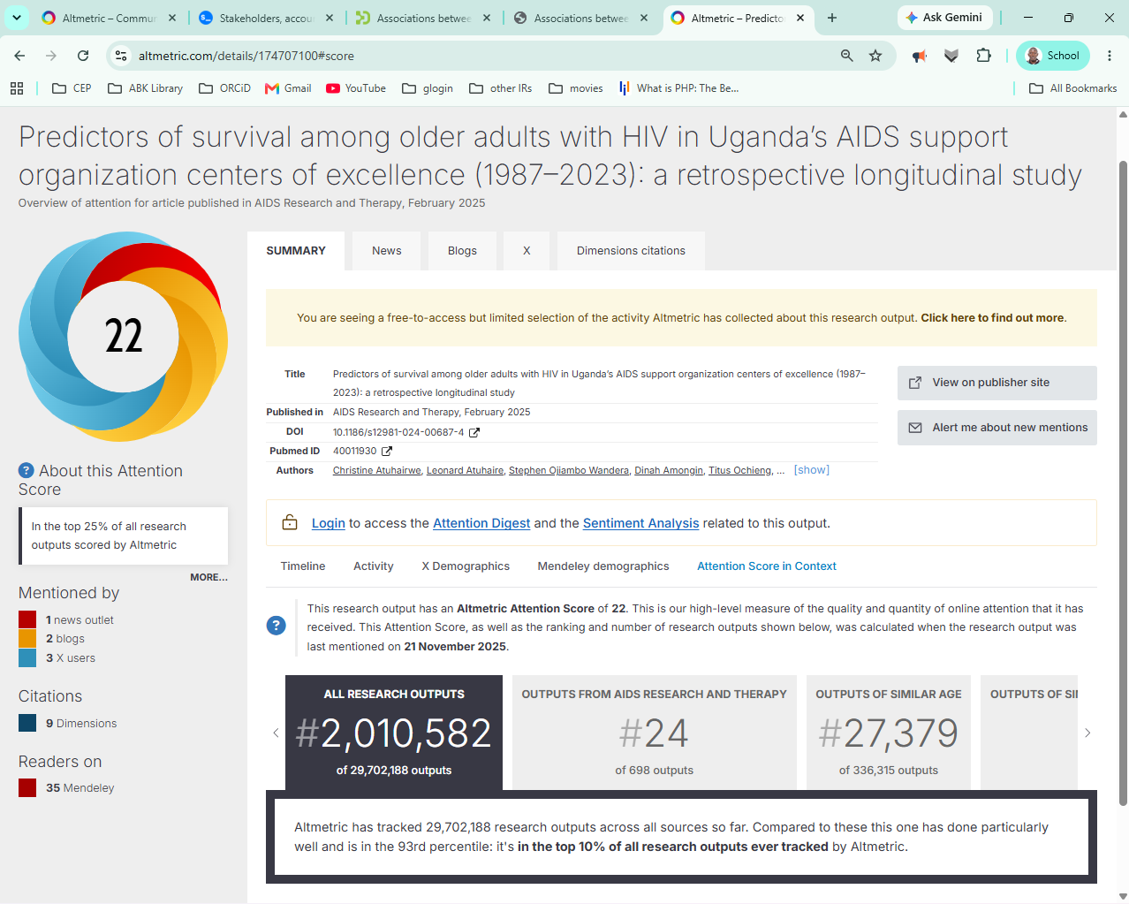
explained
‹ Back
Contents
Next ›

Slide 15
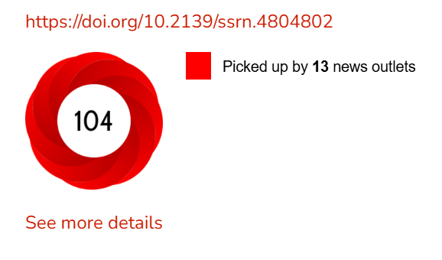
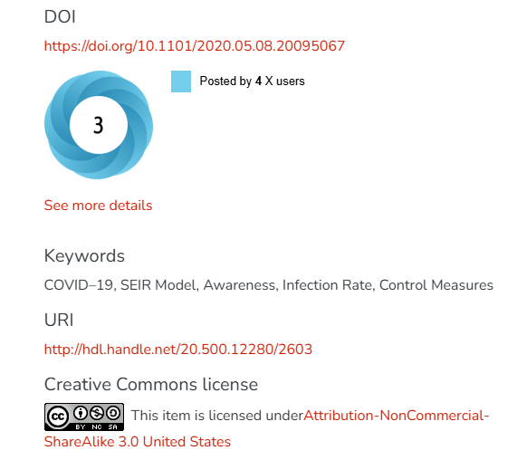
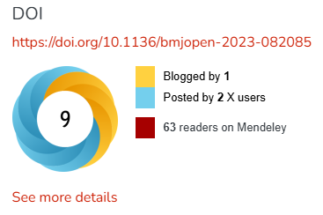
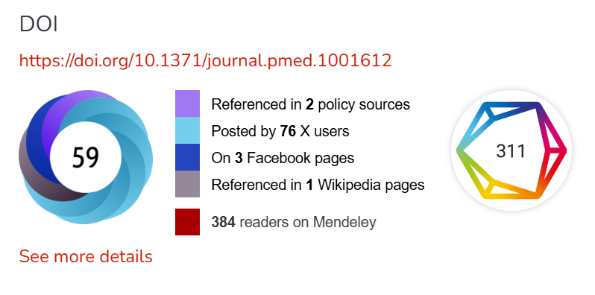
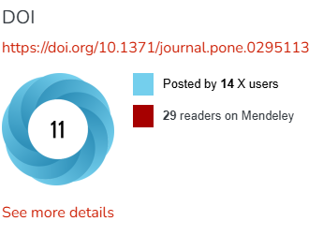
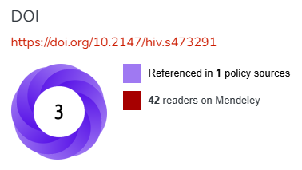
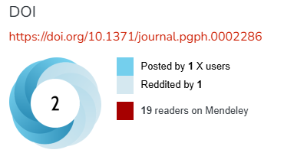
COLOURS
‹ Back
Contents
Next ›

Slide 16
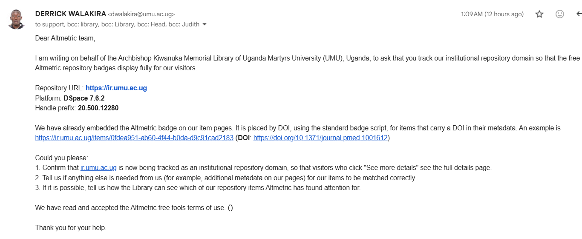
Altmetric badges for the Uganda Martyrs University Institutional Repository (ir.umu.ac.ug) - support@altmetric.com
‹ Back
Contents
Next ›

Slide 17
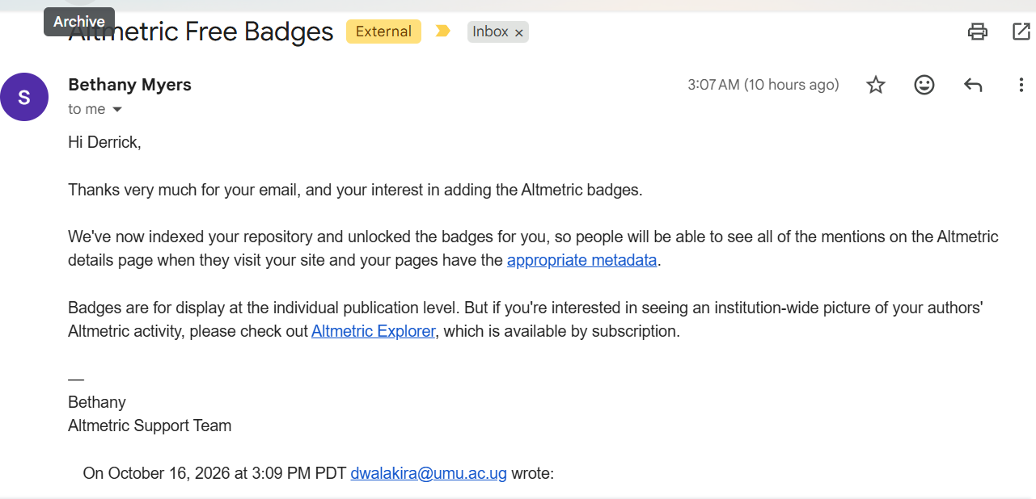
Reply from Altmetric
‹ Back
Contents
Next ›
Status: repository indexed and badges unlocked. An institution-wide view needs Altmetric Explorer (subscription).

Slide 18
Added Citations of research items using dimensions.ai
‹ Back
Contents
Next ›
Building Research Capacity in Africa: Equity and Global Health Collaborations
Kyamanywa, Patrick
https://ir.umu.ac.ug/items/0fdea951-ab60-4f44-b0da-d9c91cad2183
NOTE: Dimension Not seen when using UMU internet.

Slide 19
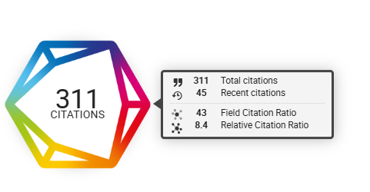
How to read the Dimensions circle
‹ Back
Contents
Next ›
Total citations. The circle shows how many citations Dimensions has found for the item’s DOI.
Hover for detail. The panel shows total and recent citations, and two ratios.
Hidden when empty. No DOI or no citations means no circle.
Placement. To the right of the Altmetric donut, at 60% of its normal size.
Terms. Free for academic institutions’ open, non-commercial sites. Keep a dated copy of the terms page.
Reading the ratios
The Field and Relative Citation Ratios compare a paper with others of the same age and field. Above 1 means it is cited more than average.
Example: 311 total, 45 recent.
Notes:
The example numbers come from a Dimensions test DOI, not a UMU item. On the repository the circle appears only when Dimensions has at least one citation for the item.

Slide 20
Added Creative Commons License
‹ Back
Contents
Next ›

Slide 21
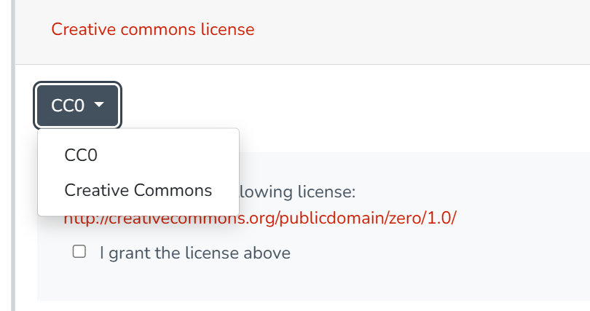
Creative Commons in the deposit form
‹ Back
Contents
Next ›
Required step. Every depositor must choose a licence. None is pre-selected.
Two choices. Creative Commons (a few questions give a standard licence) or CC0.
International version. The US default was switched off.
On the item page. Licence name, link and button. The buttons are stored on UMU’s server because the UMU network blocks the Creative Commons image site.
Older records. Items that already had a licence keep it.
Notes:
The step is mandatory. If management later prefers it optional, it is one setting in the submission configuration.

Slide 22
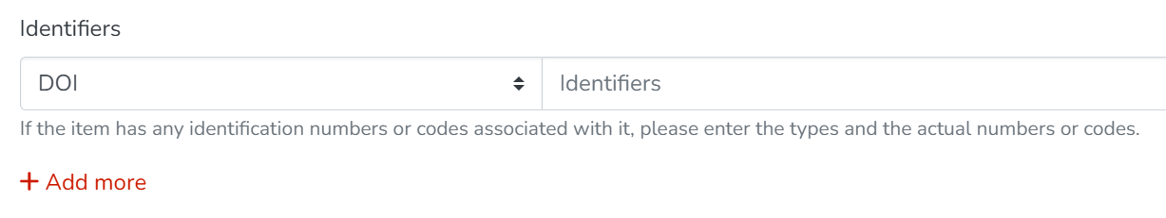
DOI choice added to the deposit form
‹ Back
Contents
Next ›
1 Choose DOI
In Identifiers, pick DOI from the list on the left.
2 Paste the full link
https://doi.org/10.xxxx/xxxxx, with no “DOI:” in front and no spaces.
3 Use the item’s own DOI
Not a DOI from a paper it cites. It feeds the DOI link, the donut and the Dimensions circle.
See the full entry rules ›
Notes:
Before this choice existed, DOIs ended up under Other, URI and ISSN. The item page still finds DOIs in those fields for older records.

Slide 23
Cleaning up older records
‹ Back
Contents
Next ›
315
rows to fix
304
items affected
2
already correct
How librarians use the sheet
Open umu-ir-doi-cleanup.xlsx and read the “Start here” sheet.
Click an item link, then Edit and Metadata.
Add dc.identifier.doi with the suggested https://doi.org/ link.
Mark “Done?” and watch the progress table.
Rows by type of fix, from a query of the IR on 13 October 2026.
Notes:
The sheet has five types of fix. Rows with a yellow background need a person to check them first. Altmetric’s API refused requests from the server, so the list shows where DOIs sit, not which items have a donut.

Slide 24
What’s next
‹ Back
Contents
Next ›
ORCID login and author iDs. Register the IR on orcid.org first.
DOI clean-up. Send the sheet to the librarians. All new deposits use the DOI choice.
Backups. Confirm they exist, and test a restore.
Get found. Add the DOI citation tag, register with CORE, BASE and OpenAIRE, and submit the sitemap to Google Search Console.
Policy page. Licences, embargoes and who may deposit.
Keep current. Plan a supported DSpace release, a newer Node version and more server memory.

Slide 25
ORCID: login and author iDs
‹ Back
Contents
Next ›
1 Login with ORCID
Register at orcid.org and verify the email.
Developer Tools: register the free Public API.
Add the redirect address of the IR backend.
Keep the Client Secret private. ICT adds it to the DSpace configuration.
Password login stays. ORCID becomes a second option.
2 ORCID iDs for authors
Store each iD beside the name, in its own field.
Authors supply their own iD. Check it on orcid.org.
Get the author’s agreement before showing it.
Helps tell apart authors with the same name, links to their profiles, and matches what funders and aggregators use.
Status: not started. Waiting for the Library to register the application.
How to register a public API client
Notes:
The credentials belong to the person who registers, so choose someone who will stay in the role. Never send the Client Secret by email or chat.

Slide 26
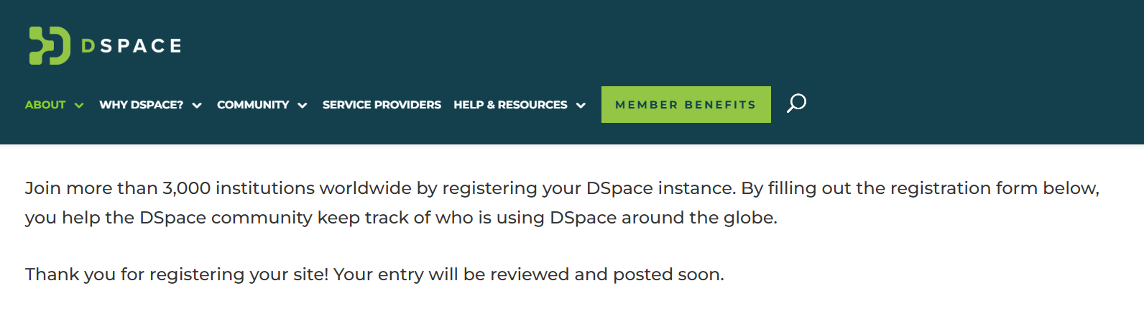
UMU IR is registered as a Dspace instance at https://dspace.org/
‹ Back
Contents
Next ›

Slide 27
Sources and references
‹ Back
Contents
Altmetric badge on a DSpace 7.6.1 item page (DSpace issue 2400)
https://github.com/DSpace/dspace-angular/issues/2400
Altmetric: adding badges to an institutional repository
https://help.altmetric.com/en/articles/9808577
Altmetric: required metadata for content tracking
https://help.altmetric.com/en/articles/9803009
Dimensions badges: embed code and terms
https://integration-dimensions-badge.digital-science.com/
ORCID: registering a public API client
https://info.orcid.org/ufaqs/how-do-i-register-a-public-api-client/
DSpace wiki: ORCID integration configuration
https://wiki.lyrasis.org/display/DSPACECRIS/ORCID+Integration+Configuration
Duke’s DSpace Angular change: Altmetric badge by DOI or Handle
https://gitlab.oit.duke.edu/ddr/dspace-angular/-/merge_requests/26/pipelines

